Slide 1

UNIT
DAY 12
01
WATCH THEM PLAY
GAMES OF LOGIC
AGENDA
REMINDERS
Phones into The Holding Cell
Lab 1-11, a pen, your game, laptops shut
What Today Is
What You Hand In
The One Rule
Your Two Metrics
How Rotations Run
The Work, In Order
Checklist
RECOMMENDED LISTENING:
HIP SHOP - DELTARUNE

Slide 2
WHAT TODAY IS
Today somebody else plays your game while you take notes
  SAYING NOTHING
Nothing today gets graded, but you’ll need to use the data you get to finish off Criteria C
  Playtest 2 in October will be graded

Slide 3
WHAT YOU HAND IN TODAY
You’ll fill in the lab sheet today as you go, not after the fact
Folder slide 24 – a picture of your lab sheet
Folder slide 25 – an update to your change log
  At the end of today, you’ll brainstorm 3 changes you can make to fix issues with your game, and you should log that
  Both folder slides are due before you leave, or before next class at the very latest

Slide 4

THE ONE RULE - SAY NOTHING
When you are the designer you do not talk
  Not to correct, not to help
The second you explain something, you have spent your only chance to see the game the way a stranger sees it
Write down what they said, not what you think they meant
  "This is confusing“ a quote vs They were confused about scoring - a guess

Slide 5
CHOOSING YOUR TWO METRICS
On your sheet, you‘ll choose two things you’d like to measure that are reflective of your
  Teach time and play time come out of the constraints, so those are already on the sheet
Pick two more that would actually tell you whether your game works
  Not "was it fun“
  Something you can count or time: turns before somebody is out of it, how many times a rule got looked up, how many people opened with the same move
Try to make it apply to one of your spec lines
→ LAB Q1

Slide 6
HOW THE ROTATIONS RUN
Rotations of fifteen minutes each, I’ll keep track of the time
  Depending on size of the room, there might be more than one group
Each round one of you is the designer
  You hand over your rules sheet and then say nothing
The other three read the sheet cold and play
So you are the designer once with real testers, and you play other people’s games
Groups of three run three rounds and go straight to Q4 at the end

Slide 7
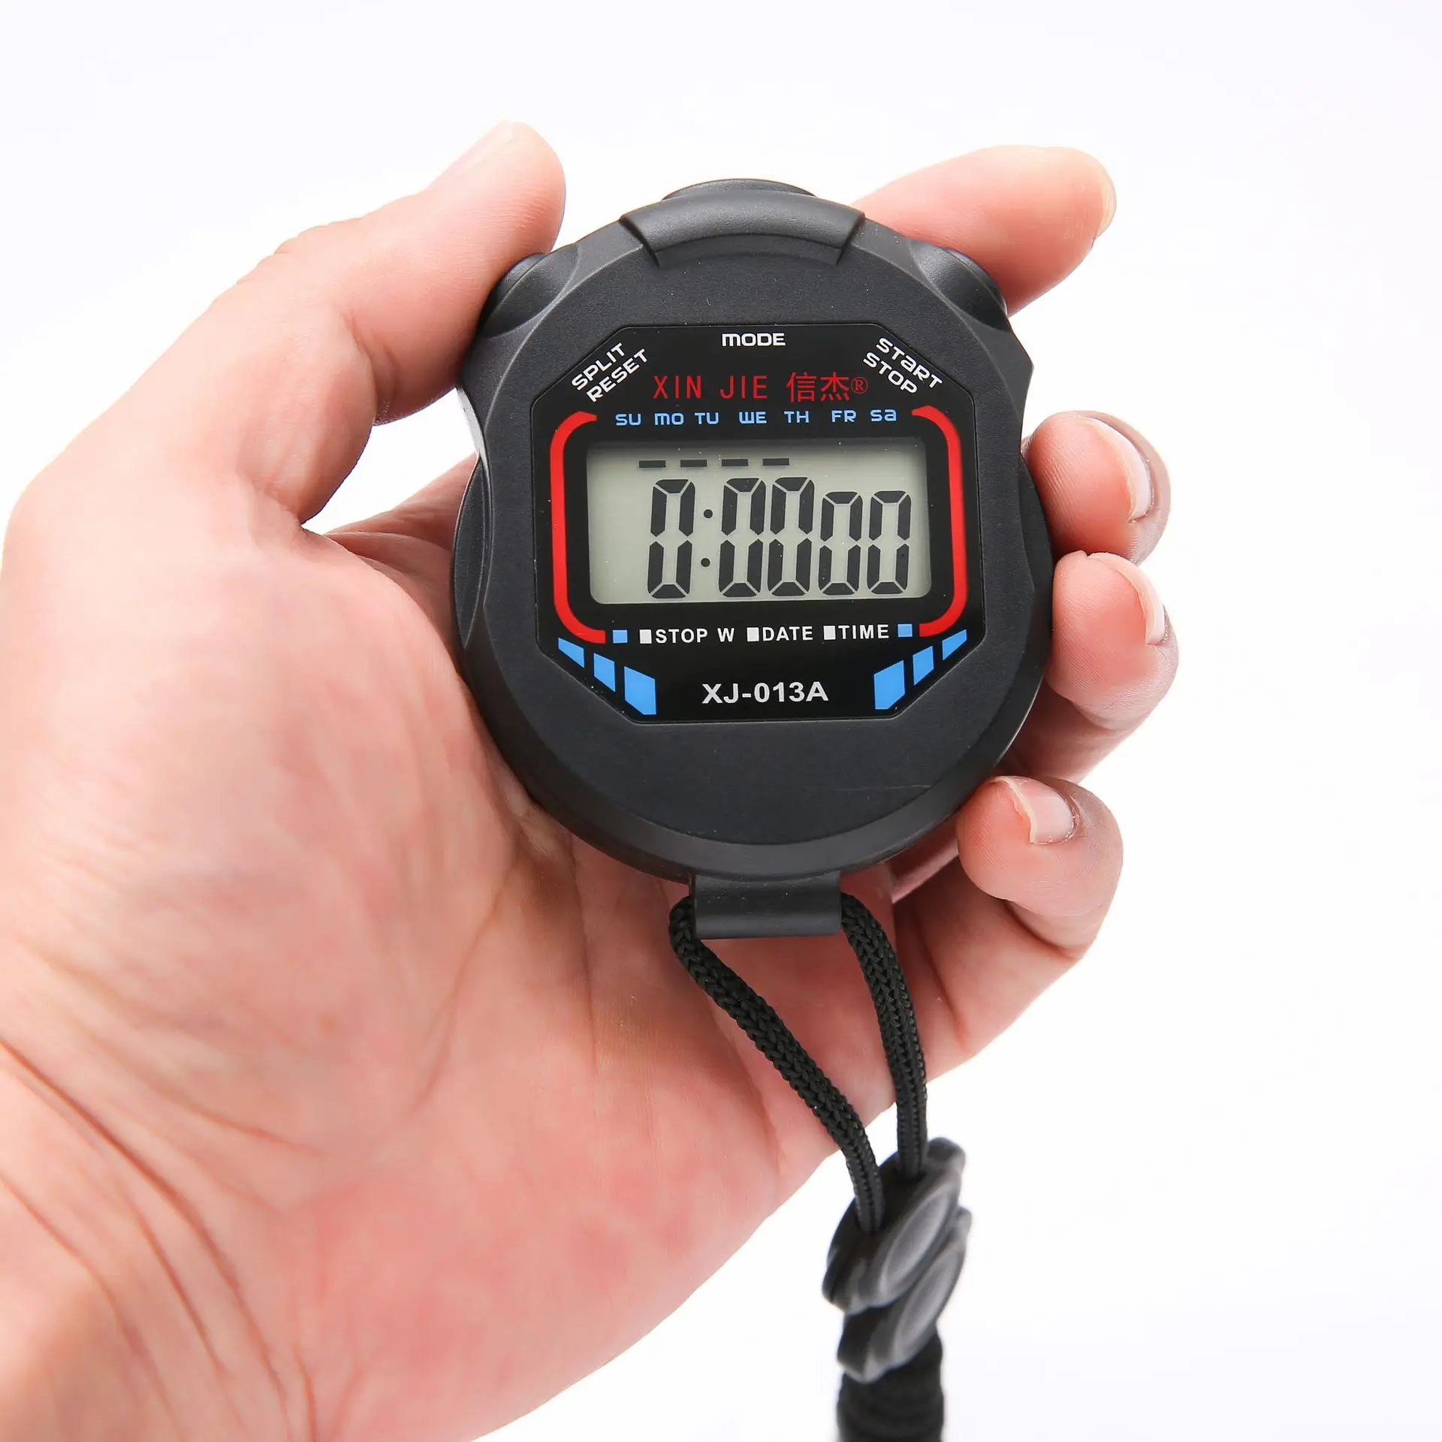
WHY EACH ROUND IS FIFTEEN MINUTES
3 to teach it, 10 to play it, 2 to write/setup. Look familiar?
  That is constraint 1 plus constraint 2 with some time for slack
If your game does not finish inside the round, stop anyway and write down how far they got
You have not failed, you have measured constraint 2

Slide 8
IN YOUR OWN ROUND
Hand over the rules sheet. Then nothing comes out of your mouth for fifteen minutes
Q2a - who played, plus teach time and play time against the constraints
Q2b - every question they had to ask you. Each one is a hole in your rules sheet
Q2c - two things they actually said, in their words
Start the clock when they start reading, not when they start playing
→ LAB Q2a, Q2b, Q2c

Slide 9
IN THE OTHER THREE ROUNDS
You are a tester for forty five minutes today, so make it count
  Read the sheet cold. Do not let them help you
If you are stuck, that is their problem to find out about, not yours to solve
One row per game in Q3, and the last column is the Day 7 question again: what does this game do that mine will have to do?
→ LAB Q3

Slide 10
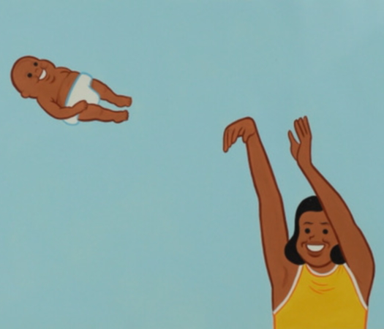
THREE FIXES, KEEP ONE
Identify your biggest problem first
Then, explain three different ways you could fix it
  Keep one
The keeper goes on folder slide 25 with its reason
→ LAB Q4

Slide 11
IF YOU MISSED TODAY
You cannot recreate the room, but you can recreate the test
1. Fill in Lab Q1 before anybody plays. Two metrics, each with a spec line
2. Find three people outside class, hand them the rules sheet, and say nothing for fifteen minutes
3. Fill in Q2a, Q2b and Q2c at the table while they play
4. Q4 - three fixes, keep one, and put the keeper on folder slide 25 with its reason
5. Photograph the sheet onto folder slide 24
Tell me who tested and when. Outside testers count, they just have to be real

Slide 12
CHECKLIST BEFORE YOU LEAVE
Folder slide 24 - your capture sheet, photographed in
Folder slide 25 - the fix you kept, with the reason next to it
Your rules sheet has notes all over it now. Keep it. That marked-up copy is more useful than the clean one

